Slide 1

Evolution of global biodiversity
Friederike Wölke

Slide 2
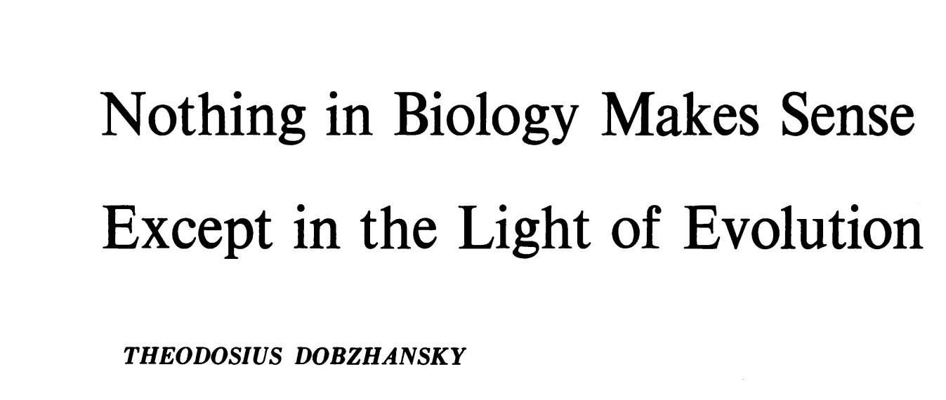
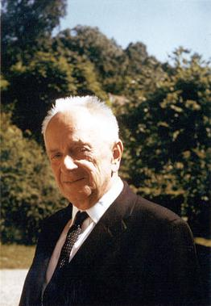
Some wise words…
„Seen in the light of evolution, biology is, perhaps intellectually the most satisfying and inspiring science. Without that light it becomes a pile of sundry facts – some of them interesting or curious but making no meaningful picture as a whole.“
- T. Dobzhansky (1973)

Slide 3
What you should remember
The number of taxa steadily increased through geological time
There have been 5 major extinction events (the “big five”) and we are likely approaching another one
Apart from extinction, the other process that generates biodiversity is speciation
The principle of Darwinian natural selection, and how it’s connected to speciation
Evolutionary relationships among organisms are represented by a phylogeny a.k.a. phylogenetic tree
Besides biological processes, biodiversity patterns globally are determined by extinctions and plate tectonics
Resource: Origins of Biodiversity, Bromham & Cardillo, 2019 (Book) *click for pdf*

Slide 4
How biodiversity came to be?
Biodiversity through geological time

Slide 5
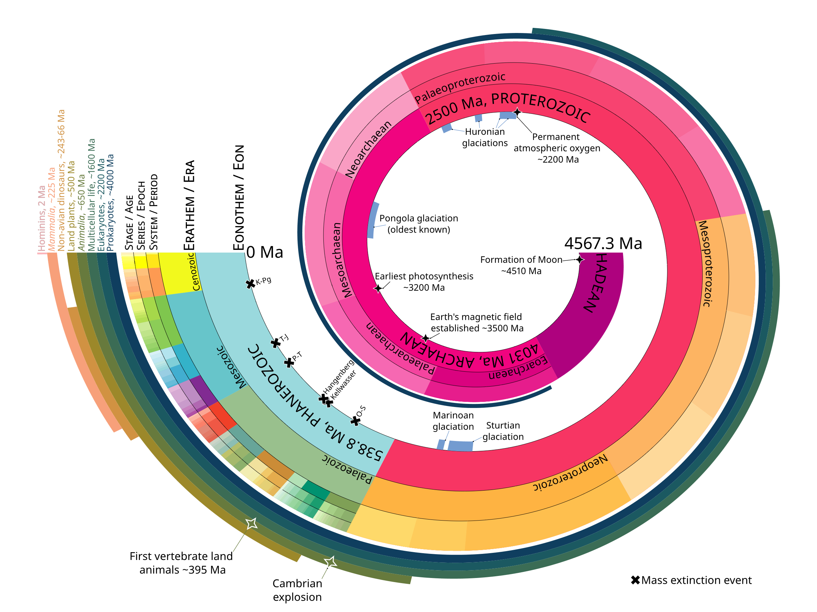
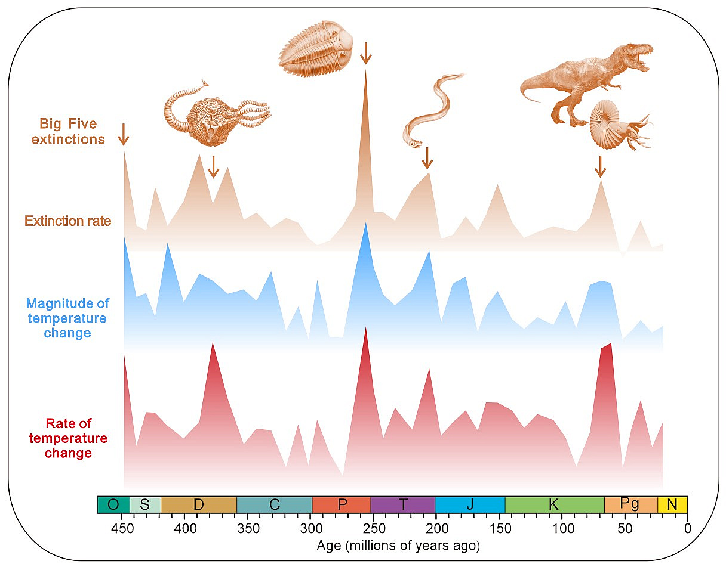
Biodiversity through geological time
Fundamental eco-evolutionary processes that determine how many species there are in a given area:
Speciation = production of new species
Extinction = loss of species
Dispersal = immigration/emigration of species

Slide 6
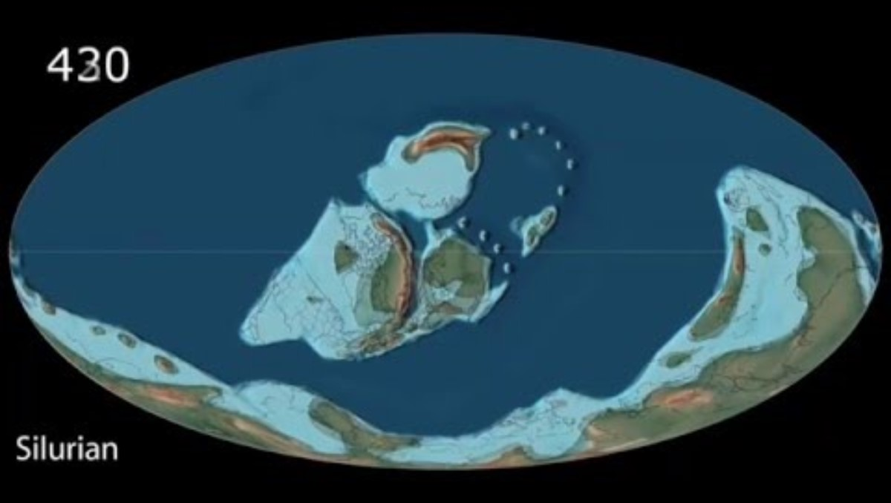

Slide 7
The vanishing of a species
Extinctions and mass extinctions

Slide 8
Extinction
What is extinction?
= the dying out / termination of a species; i.e., the dying out of all individuals that belong to a species
How can we define and compare extinctions?
Spatial:
Global extinctions vs. local- to regional-scale extirpations
Temporal:
Extinctions from the fossil record vs. recent historical extinctions
Length of the time interval to calculate extinction rates (past vs. present)
Other types:
With low abundance, a species can become ecologically, functionally or economically extinct before it is truly extinct
Notes:
Side note and some Background:
Nowadays IUCN defines ‚extinction‘ as the death of the last individual of a species – which is very hard to detect and thus many extinctions may go undocumented. For a species to be labelled ‚extinct‘ rigorous field surveys over the entire original range of the species have to be conducted. Labelling a species as extinct also may be undesirable because of potential withdrawl of research efforts and funding. Thus, most species are extinct long before they are documented to be extinct. But also, many times species that have been undiscovered (potentiall extinct) for many decades can sometimes be rediscovered even after considerable amounts of time. The take home here: We know very little about individuals of species which makes it hard to quantify when the last individual has died.

Slide 9
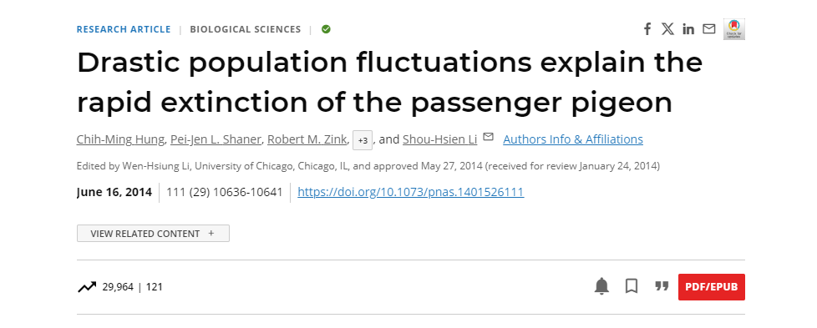
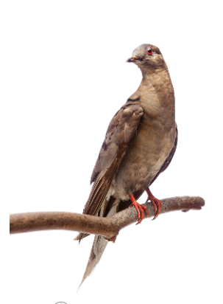
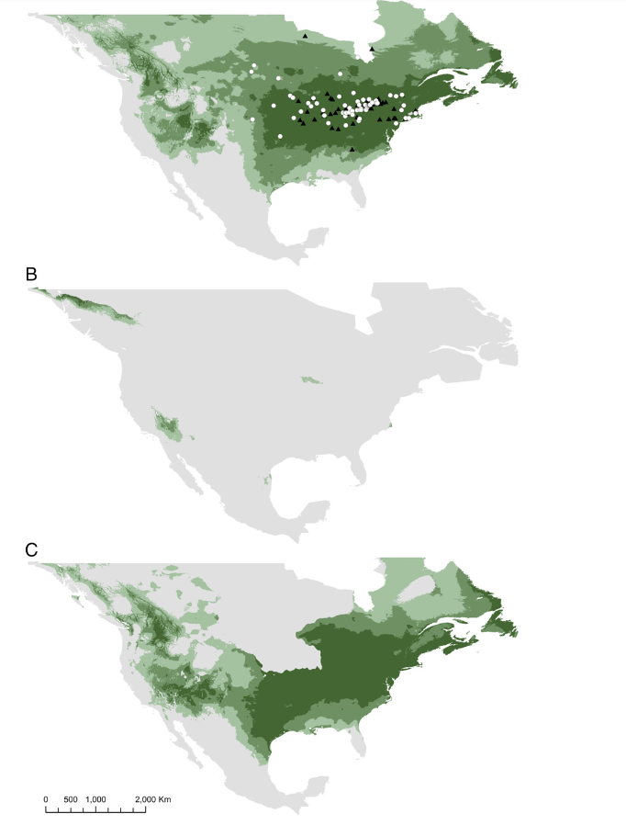
The passenger pigeon (Ectopistes migratorius) - the fast track to extinction
The most abundant bird in North America (and potentially the world) in the early 1800s (3-5 billion individuals)
Millions of individuals were hunted every year by the settlers because it was ‘cheap meat’
The species was eradicated by Europeans within a human life span (approx. 70 years)
Birds bred in massive colonies of billions of individuals, making them vulnerable to density-dependent regulatory factors (e.g., infectious diseases, overexploitation)
MARTHA
Last of her species, died at 1 p.m., 1 September 1914, age 29, in the Cincinnati Zoological Garden. EXTINCT

Slide 10
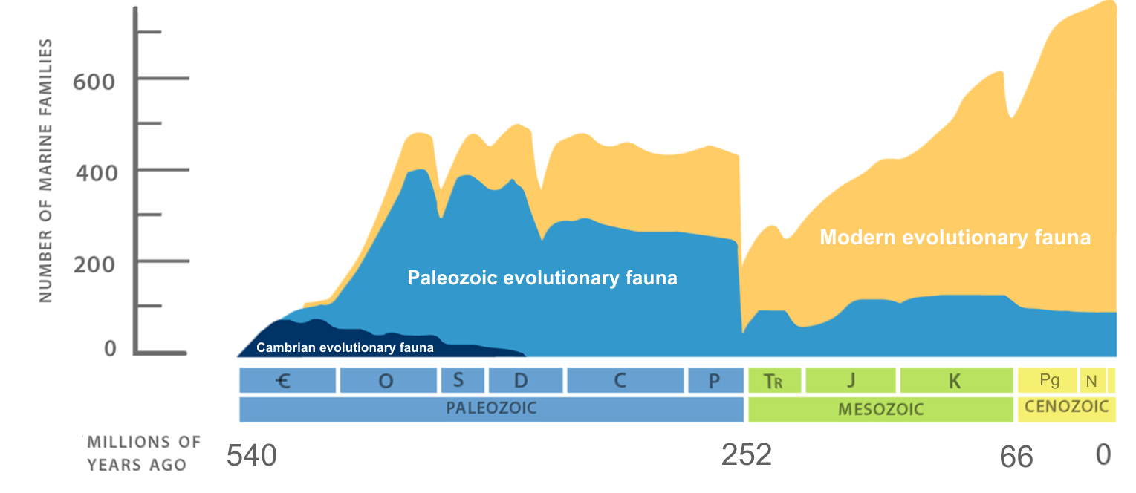
Mass Extinctions
(5)
(1)
(2)
(3)
Technical definition:
Mass Extinction event = the loss of at least 75% species over a relatively short period in geological time
(4)
‘Sepkoski curve’ of marine diversity changes (adapted from Raup & Sepkoski (1982), Science)
Notes:
- Short period usually ~ less than 2.8 million years
- Debate whether the Big Five were quantiatively different from other extinction events that have occurred throughout earth’s history, or if they were just the largest on a CONTINUOUS SCALE of extinction severity.
Jack Sepkoski & David Raup defined the term in 1982:
Raup DM, Sepkoski JJ (1982) Mass extinctions in the marine fossil record.
Science 215: 1501–3.
Historically – insights from paleontology and the fossil record: The disappearance from the fossil record of a large proportion of the known taxa: > 60% species; > 50% genera, 17% of families.

Slide 11
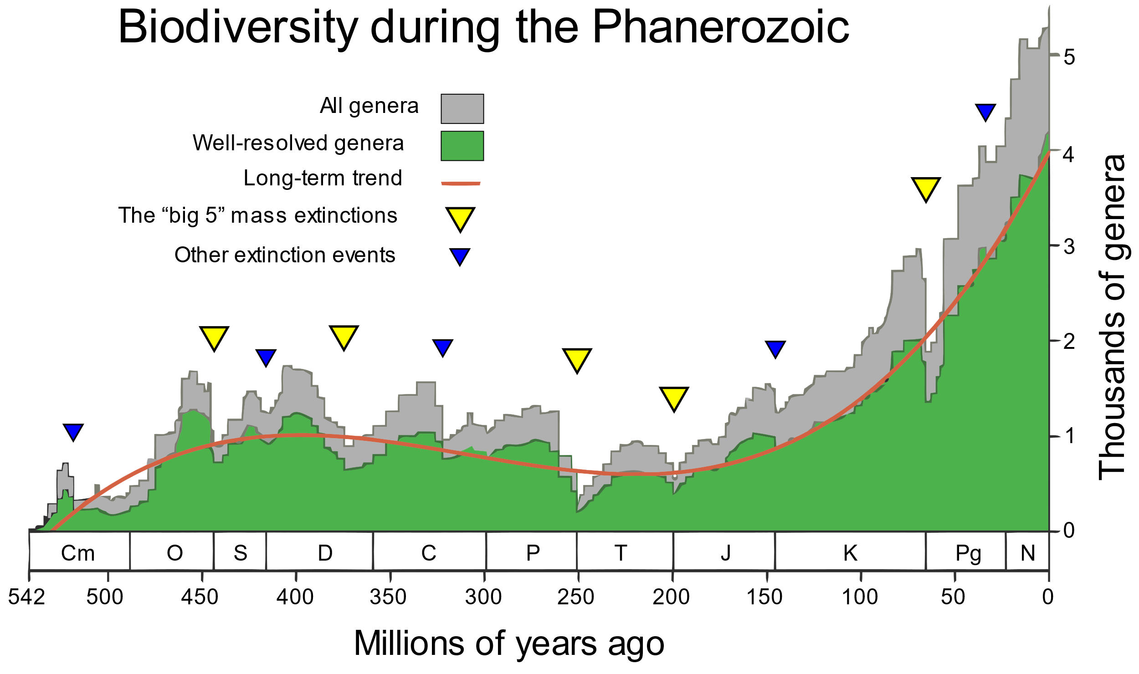
“The Big 5” Mass Extinctions: 1/5
(5)
Ordovician – Silurian mass extinction
Time: 440 Mya - Ordovician-Silurian:
Impact: 100 families of marine life extinct, incl. half of all genera
Cause: Rapid cooling (Gondwana passed the pole, period of glaciation)
(1)
(2)
(3)
(4)
Notes:
Time (mya)
Name
Impact
Cause
440
Ordovician-Silurian
100 families of marine life extinct, incl. half of all genera
Rapid cooling (Gondwana passed the pole, period of glaciation)
365
End-Devonian
20% of all families lost, mostly marine organisms (corals, invertebrates)
Removal of CO₂ from the atmosphere after the emergence of land plants
250
Permian-Triassic
Extinction of 90% of all species, marine and land
Massive volcanism, methane release (asteroid impacts?)
200
End-Triassic
Loss of large amphibians, plants and marine species
Unclear
65
Cretaceous-Tertiary (K-T)
Extinction of dinosaurs and many marine species
Extra-terrestrial impacts (asteroid in now southern Mexico)

Slide 12
“The Big 5” Mass Extinctions: 2/5
End-Devonian mass extinction
Time: 365 Mya - End-Devonian
Impact: 20% of all families lost, mostly marine organisms (corals, invertebrates)
Cause: Removal of CO₂ from the atmosphere after the emergence of land plants
(5)
(1)
(2)
(3)
(4)
Notes:
Time (mya)
Name
Impact
Cause
440
Ordovician-Silurian
100 families of marine life extinct, incl. half of all genera
Rapid cooling (Gondwana passed the pole, period of glaciation)
365
End-Devonian
20% of all families lost, mostly marine organisms (corals, invertebrates)
Removal of CO₂ from the atmosphere after the emergence of land plants
250
Permian-Triassic
Extinction of 90% of all species, marine and land
Massive volcanism, methane release (asteroid impacts?)
200
End-Triassic
Loss of large amphibians, plants and marine species
Unclear
65
Cretaceous-Tertiary (K-T)
Extinction of dinosaurs and many marine species
Extra-terrestrial impacts (asteroid in now southern Mexico)

Slide 13
“The Big 5” Mass Extinctions: 3/5
(5)
Permian-Triassic mass extinction
Time: 250 Mya - Permian-Triassic
Impact: Extinction of 90% of all species, marine and land
Cause: Massive volcanism, methane release (asteroid impacts?)
(1)
(2)
(3)
(4)
Notes:
Time (mya)
Name
Impact
Cause
440
Ordovician-Silurian
100 families of marine life extinct, incl. half of all genera
Rapid cooling (Gondwana passed the pole, period of glaciation)
365
End-Devonian
20% of all families lost, mostly marine organisms (corals, invertebrates)
Removal of CO₂ from the atmosphere after the emergence of land plants
250
Permian-Triassic
Extinction of 90% of all species, marine and land
Massive volcanism, methane release (asteroid impacts?)
200
End-Triassic
Loss of large amphibians, plants and marine species
Unclear
65
Cretaceous-Tertiary (K-T)
Extinction of dinosaurs and many marine species
Extra-terrestrial impacts (asteroid in now southern Mexico)

Slide 14
“The Big 5” Mass Extinctions: 4/5
(5)
End-Triassic mass extinction
Time: 200 Mya - End-Triassic
Impact: Loss of large amphibians, plants and marine species
Cause: Unclear
(1)
(2)
(3)
(4)
Notes:
Time (mya)
Name
Impact
Cause
440
Ordovician-Silurian
100 families of marine life extinct, incl. half of all genera
Rapid cooling (Gondwana passed the pole, period of glaciation)
365
End-Devonian
20% of all families lost, mostly marine organisms (corals, invertebrates)
Removal of CO₂ from the atmosphere after the emergence of land plants
250
Permian-Triassic
Extinction of 90% of all species, marine and land
Massive volcanism, methane release (asteroid impacts?)
200
End-Triassic
Loss of large amphibians, plants and marine species
Unclear
65
Cretaceous-Tertiary (K-T)
Extinction of dinosaurs and many marine species
Extra-terrestrial impacts (asteroid in now southern Mexico)

Slide 15
“The Big 5” Mass Extinctions: 5/5
(5)
Cretaceous-Tertiary mass extinction (K-T)
Time: 65 Mya - Cretaceous-Tertiary (K-T)
Impact: Extinction of dinosaurs and many marine species
Cause: Extra-terrestrial impacts (asteroid in now southern Mexico)
(1)
(2)
(3)
(4)
Notes:
Time (mya)
Name
Impact
Cause
440
Ordovician-Silurian
100 families of marine life extinct, incl. half of all genera
Rapid cooling (Gondwana passed the pole, period of glaciation)
365
End-Devonian
20% of all families lost, mostly marine organisms (corals, invertebrates)
Removal of CO₂ from the atmosphere after the emergence of land plants
250
Permian-Triassic
Extinction of 90% of all species, marine and land
Massive volcanism, methane release (asteroid impacts?)
200
End-Triassic
Loss of large amphibians, plants and marine species
Unclear
65
Cretaceous-Tertiary (K-T)
Extinction of dinosaurs and many marine species
Extra-terrestrial impacts (asteroid in now southern Mexico)

Slide 16
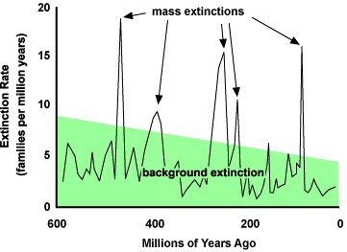
‘Sixth Mass Extinction’ – How do we know?
How do we know it’s not just business-as-usual?
The background rate of extinction = the average extinction rate due to non-human causes over geological history
(approx. 1 E/MSY on average)
e.g., Mammal background rate = 2 mammal extinctions per 10,000 species per 100 years (that is, 2 E/MSY) (Ceballos, Ehrlich et al. 2015, SciAdv)
* E/MSY = Extinction per million of species years (to standardize comparisons among different time periods and sets of species)
Notes:
Exinctions happen continuously through time – even without mass extinctions. → Thus there is a background rate.
Requires extrapolating current rates to 1 million-year period
Fossil record is highly selective, we know nothing about the majority of species → this is a super rough estimate with high uncertainty.
Fossil record underestimates the true number of taxa present because not all taxa fossilize
Fossil record is betterr with families and very bad with species (fossils are often fragments or imprints of organs that do not enable the identification to species level)
Fossil record is biased towards over-estimation of extinction rates because the longlivety of species is ignored. The last appearance of a species in the fossil record is probably never the last individual that died, thus, the actual extinction has probably taken place after the dissappearance from the fossil record.
this all means that the background rate is biased as well and tends to underestimate the true background extinction rate.
Listing species extinct in current time scales (i.e., without the fossil record) will underestimate the true number of extinctions because the death of the last individual will follow with a time lag.

Slide 17
‘Sixth Mass Extinction’ – How do we know?
How do we know it’s not just business-as-usual?
Díaz & Malhi (2022) Annu. Rev. Environ. Res.

Slide 18
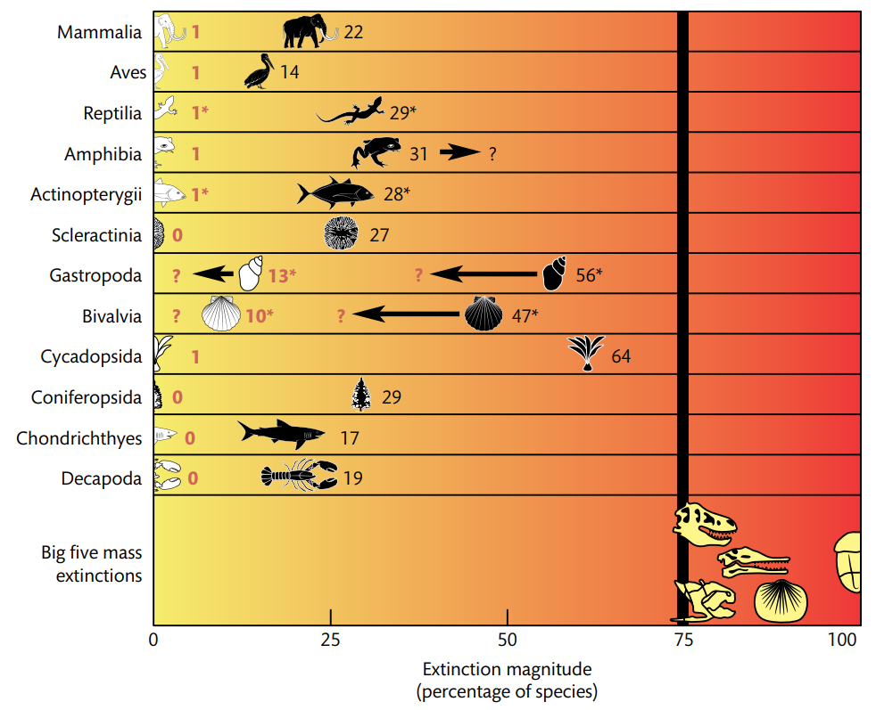
‘Sixth Mass Extinction’ – How do we know?
Evidence:
Present-day extinction rates exceed the background rate
Mass extinction of species in the next few centuries cannot be ruled out
Doubts:
The definition of a ‘relatively short period of time’ depends on the temporal scale. Are we looking at human or geological time scales? It also depends on the cause.
Mass extinction is far from an inexorable process—human actions can make a dramatic difference as to whether such extinction rates are even reached.
It’s a hot debate.
Reprinted by Bromham & Cardillo (p. 397) from Barnosky et al. 2011, Nature
Notes:
Red numbers = percentage of recently extinct species
Black numbers = percentages of species currently listed as threatened with extinction
→ If all species currently considered threatened with extinction were to go extinct within a century, and the estimated rates of extinction were maintained, extinctions in birds, mammals and amphibians would reach Big Five magnitudes within 240–540 years. (Barnosky et al. 2011)

Slide 19
‘Sixth Mass Extinction’ – How do we know?
Threshold for
“Mass Extinction”
We are here
Evidence:
Present-day extinction rates exceed the background rate
Mass extinction of species in the next few centuries cannot be ruled out
Doubts:
The definition of a ‘relatively short period of time’ depends on the temporal scale. Are we looking at human or geological time scales? It also depends on the cause.
Mass extinction is far from an inexorable process—human actions can make a dramatic difference as to whether such extinction rates are even reached.
It’s a hot debate.
Reprinted by Bromham & Cardillo (p. 397) from Barnosky et al. 2011, Nature

Slide 20
Drivers of Extinction in the Anthropocene
The ‘evil quartet’ (sensu Diamond):
Habitat loss
Hunting
Introduced species
Extinction chains (extinction of co-dependent species)
(climate change)
Notes:
‘Evil quartet’ - J. M. Diamond, in Conservation for the twenty-first century, D. Western, M. C. Pearl, Eds. ( Oxford University Press, London, UK, 1989), pp. 37-41

Slide 21
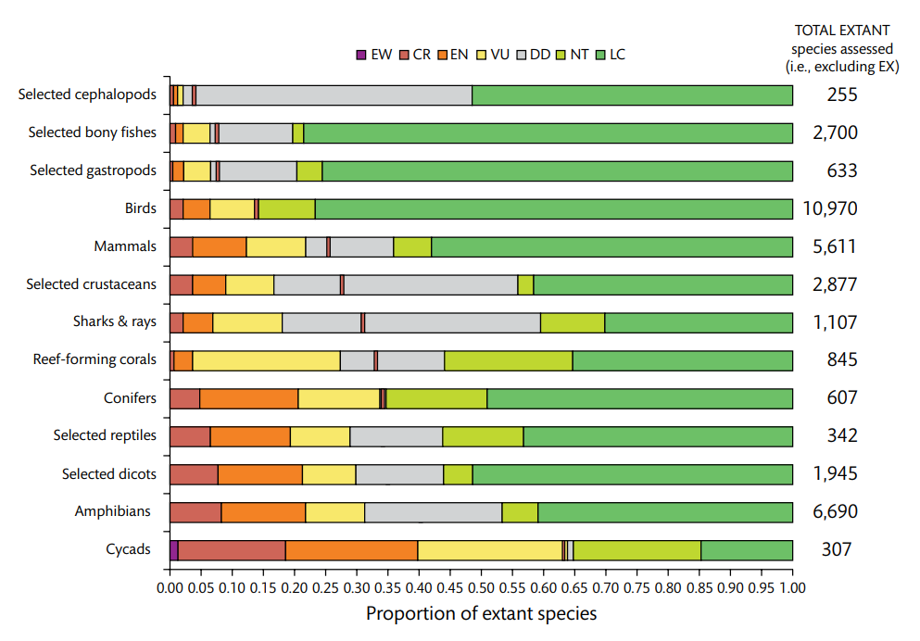
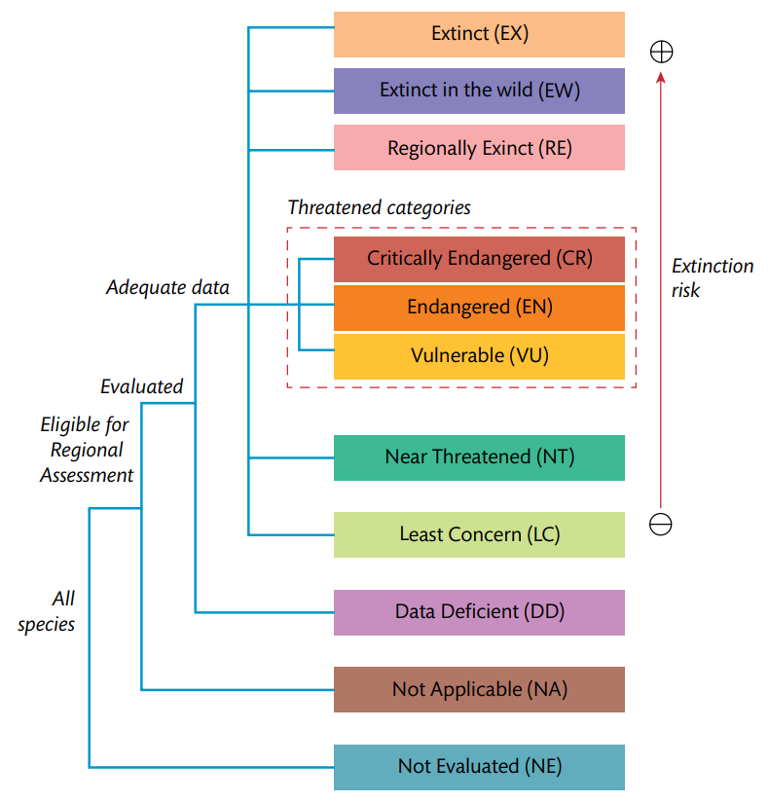
The IUCN Red List
IUCN Red List scheme:
Proportions of evaluated species only (!)
e.g., only 7639 insect species out of 1 MILLION have been evaluated.
IUCN 2018. The IUCN Red List of Threatened Species. Version 2018–2. http://www.iucnredlist.org
Notes:
Material taken from Bromham & Cardillo – Origins of biodiversity (the book is available online for you from us – if not, let me know, I have it in my google drive and will forward the link again)

Slide 22
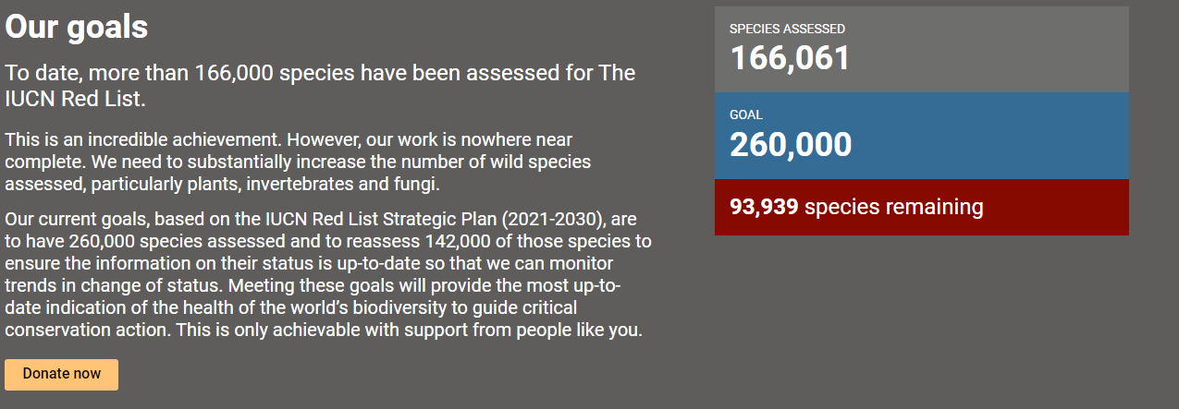
The IUCN Red List

Slide 23
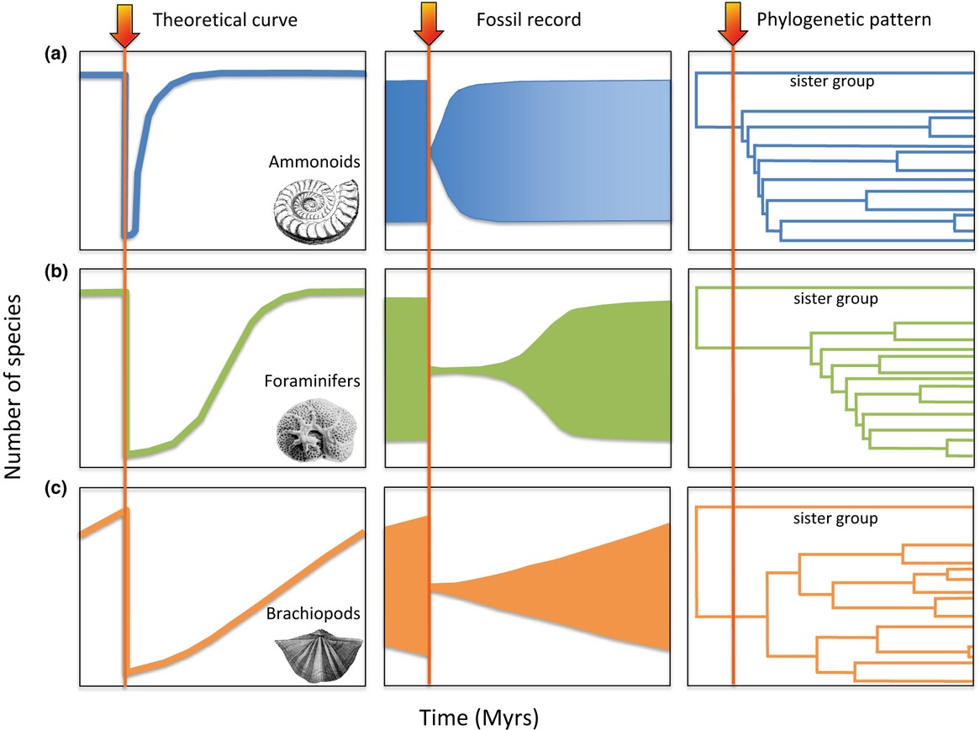
How does biodiversity recover from extinction? – Evolutionary perspective
Fast recovery
Slower recovery
‘Time-for-speciation’ recovery
Condamine et al. 2013 Ecology Letters

Slide 24
How does biodiversity recover from extinction? – Evolutionary perspective
Fast recovery
Slower recovery
‘Time-for-speciation’ recovery
Condamine et al. 2013 Ecology Letters

Slide 25
How does biodiversity recover from extinction? – Evolutionary perspective
Fast recovery
Slower recovery
‘Time-for-speciation’ recovery
Condamine et al. 2013 Ecology Letters

Slide 26
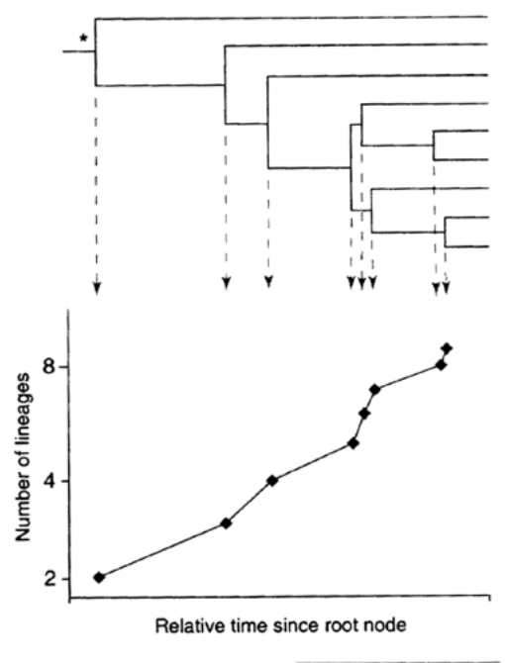
How does biodiversity recover from extinction? – Evolutionary perspective
🪄
How do we know?
Lineages-through-time plot (LTT)

Slide 27
How new species emerge
Speciation

Slide 28
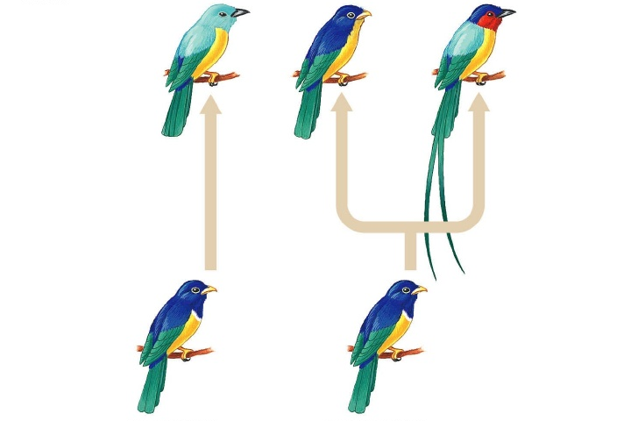
Speciation
What is speciation?
= the process by which new biological species arise
= the splitting of lineages (cladogenesis)
Anagenesis
Cladogenesis
non-branching process that transforms one ancestral species into a single descendant
splitting of an ancestral species into two or more daughter species

Slide 29
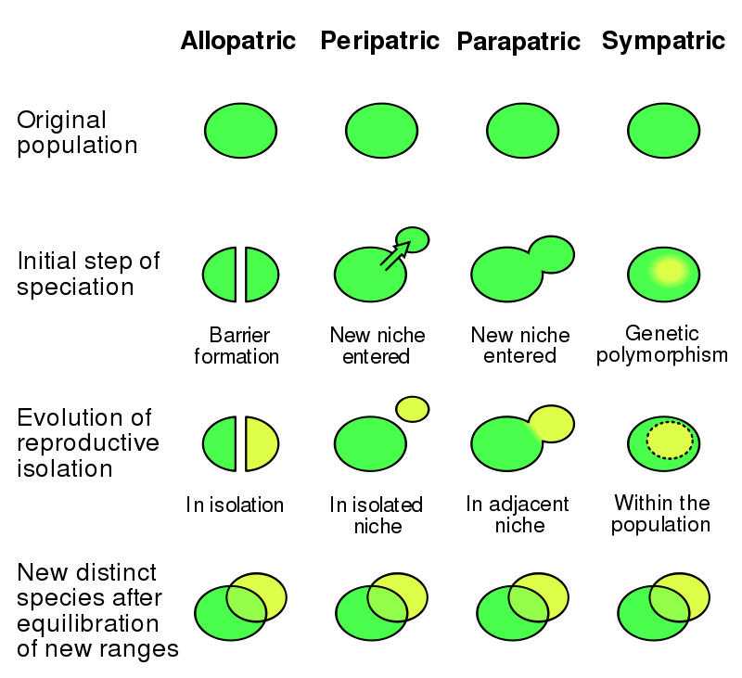
Modes of speciation
Allopatric speciation:
Most common speciation mode
Caused by limits to dispersal (barriers) and subsequent genetic drift, natural selection, and adaptation.

Slide 30
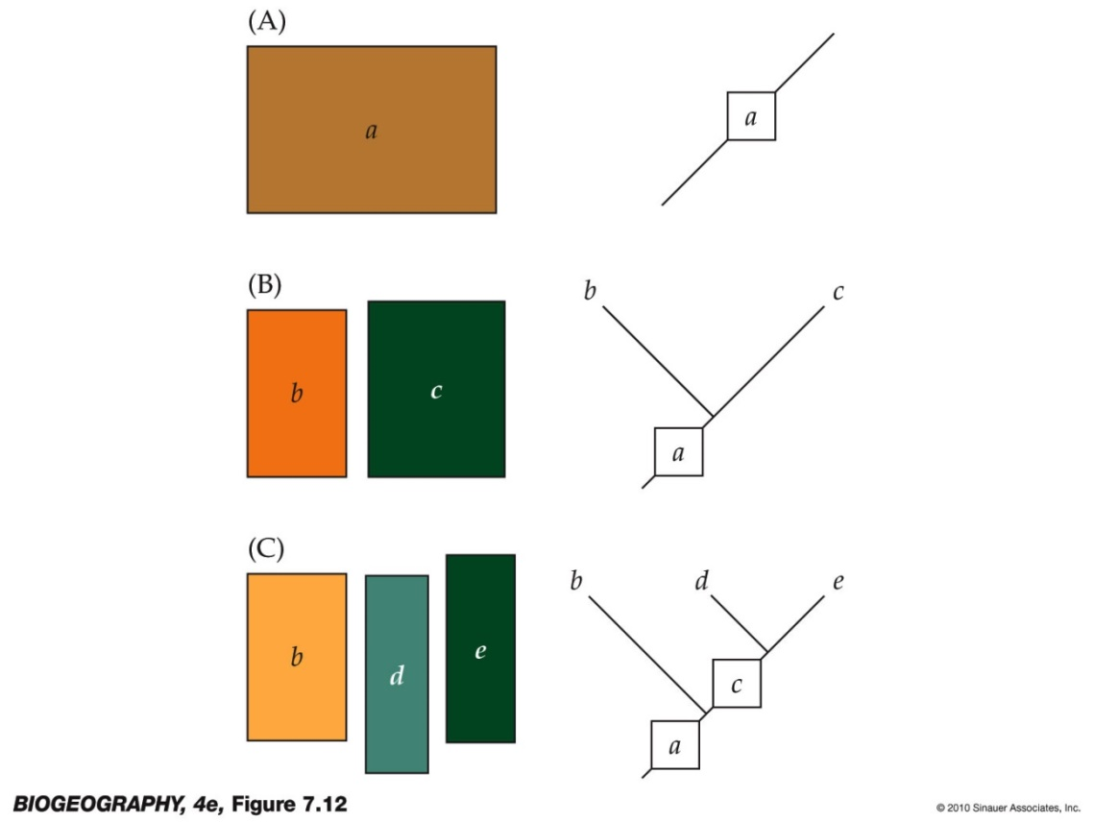
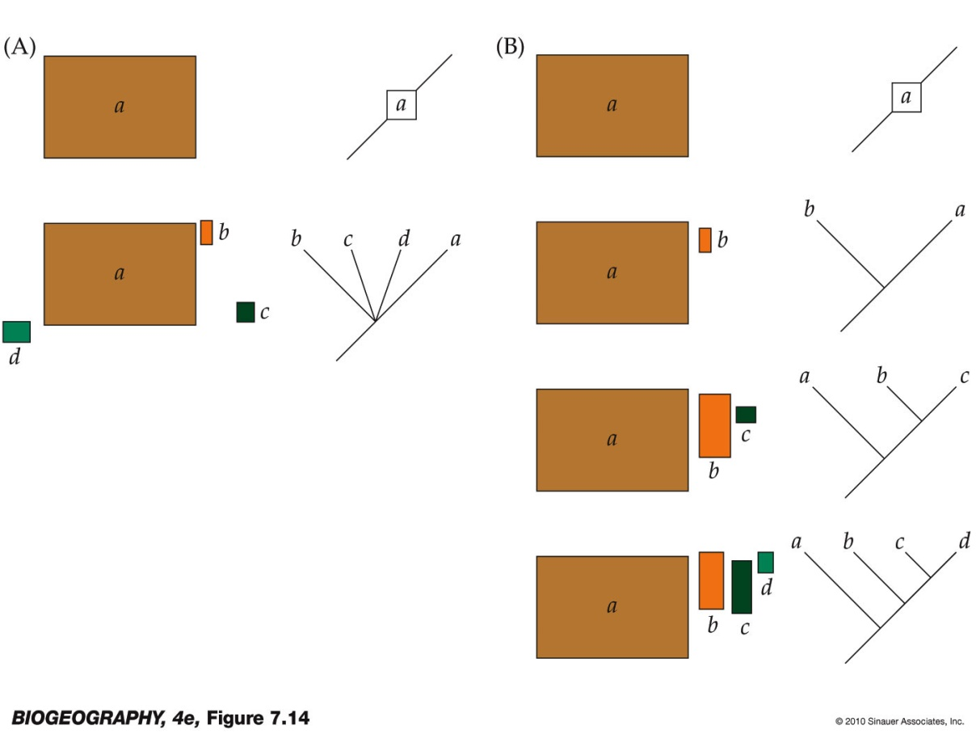
What causes allopatric speciation?
(2) Founder events (e.g., colonization of oceanic islands)
(1) Vicariance (rising sea levels, plate tectonics, etc.)
time
time
Lomolino et al. 2010, Biogeography

Slide 31
Modes of speciation
Sympatric speciation:
Speciation within spatially overlapping populations
Either due to disruptive selection (adaptation to two different environmental regimes) or chromosomal changes (e.g. polyploidy)

Slide 32
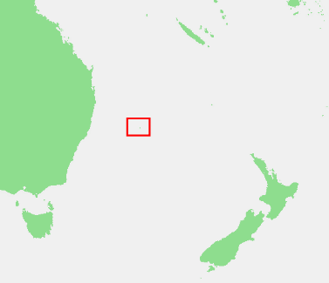
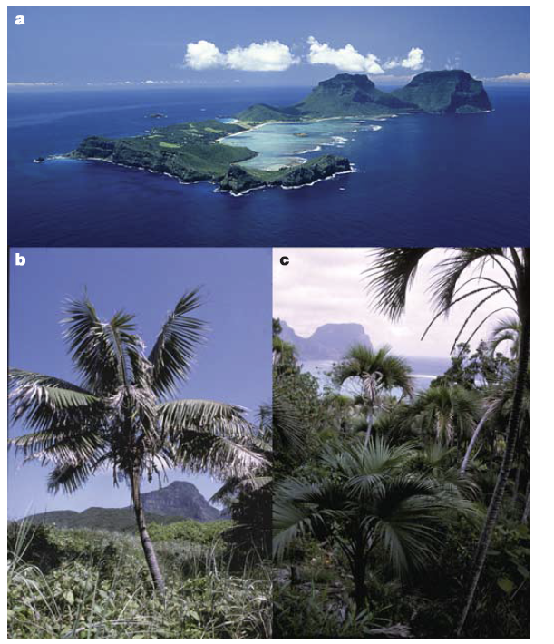
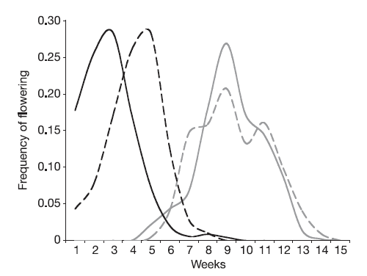
Example: Sympatric speciation of Howea palms
Sympatry: two palm species on Lord Howe Island
Sister relationship: phylogeny shows sister relationships and divergence after island formation
Reproductive isolation: disjunction in flowering time
Cause: Possibly disruptive selection (= adaptation to different soil types)
Howea forsteriana
Howea belmoreana
males (solid line) and female (dotted line)
Savolainen et al. 2006 Nature

Slide 33
Speciation rates - How do we know?
Can be derived using the number of species that are alive and time (i.e., a dated phylogeny!)
Species diversity = Speciation rate – Extinction rate
Background: genetics and the accumulation of mutations through time (molecular clock)
Assumption: Speciation occurs when two populations have evolved a certain amount of genetic distance between them via being isolated for some time
simplest assumption: speciation is exponential: one lineages splits into two new lineages
Extinction = unknown, but we can derive it mathematically by assessing the deviation from the exponential assumption for speciation
Keep in mind:
strongly dependent on completeness of the phylogeny (if species are missing, rates will not be estimated correctly – but we can account for it if we know how many species are missing)
There may be other processes of speciation (e.g., anagenesis) that do not rely on the exponential assumption (consensus is that this happens rarely or is debated generally)

Slide 34
How species change
Natural selection, adaptation and diversification

Slide 35
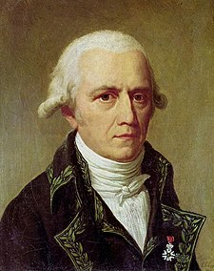
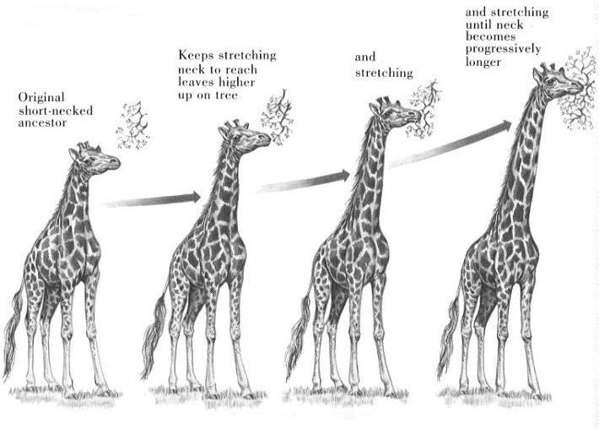
How species change: according to Lamarck
Jean-Baptiste Pierre Antoine de Monet, Chevalier de la Lamarck
(1744 – 1829)
The theory of species transformations

Slide 36
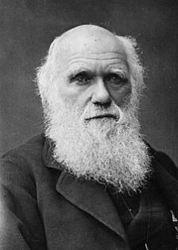
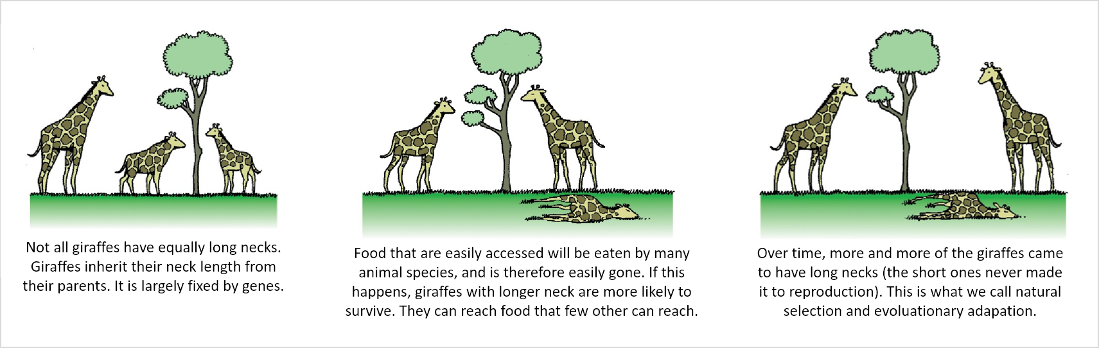
How species change: according to Darwin (natural selection)
Darwin (1859) On the Origin of Species
The theory of natural selection
Natural selection is passive (the environment selects) and acts over generations, not during lifetime.

Slide 37
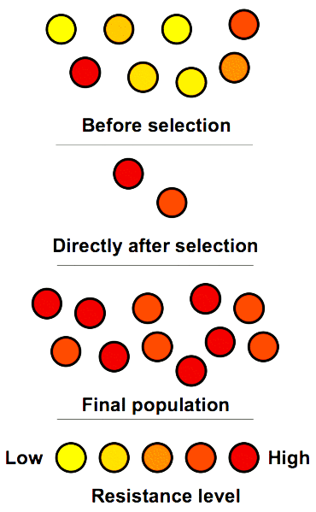
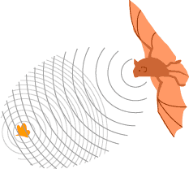
Adaptation
Adaptation
a feature (trait) produced by natural selection for its current function to enhance the fitness
Example: Echolocation in bats
Organisms do not adapt during their lifetime, the merely reproduce and die

Slide 38
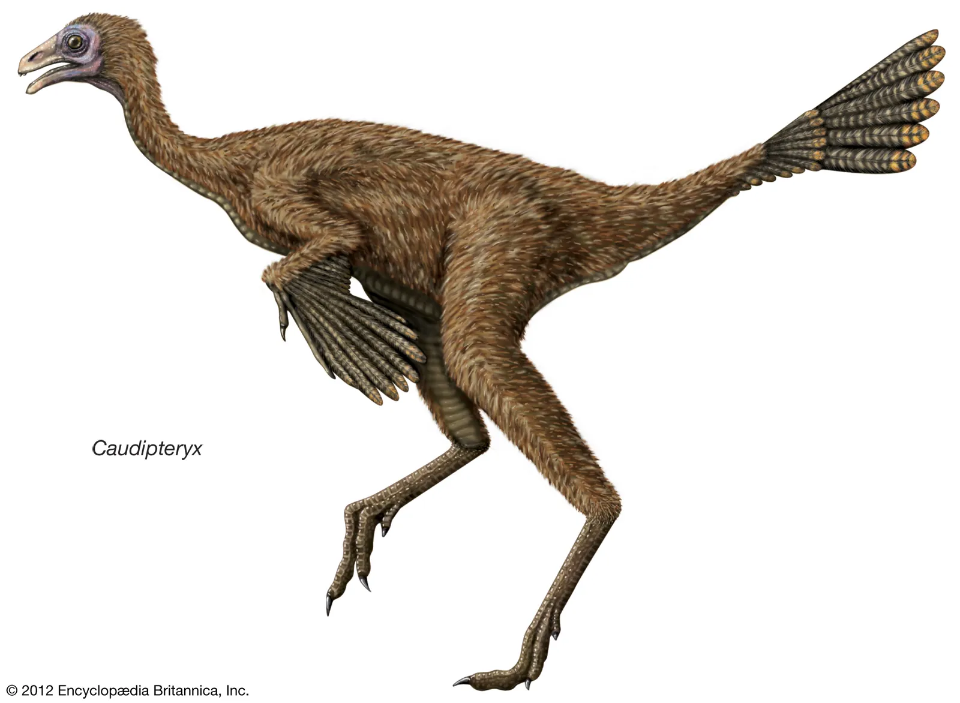
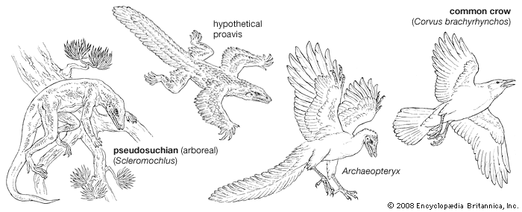
Exaptation
Exaptation
A special form of adaptation
a feature (trait) that performs a function but was not produced by natural selection for its current use
Non-adapted traits can become exaptations under new environmental circumstances
Example: Feathers in birds

Slide 39
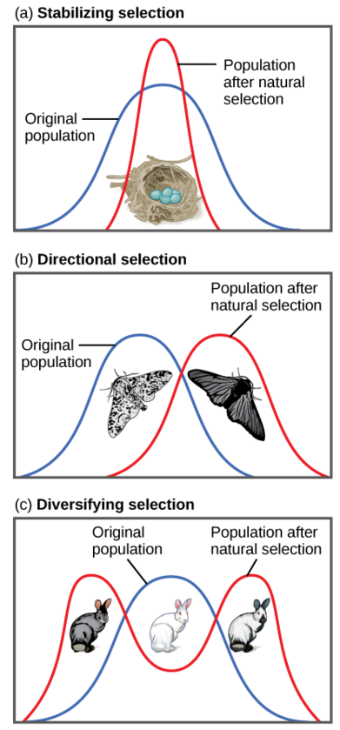
Types of natural selection: Examples
Stabilizing selection:
Robins typically lay four eggs
Larger clutches may result in malnourished chicks
Smaller clutches may result in no viable offspring
Directional selection:
Light-colored peppered moths are better camouflaged against a pristine environment
Dark-colored peppered moths are better camouflaged against sooty environment
As the industrial revolution progressed in 19th century England, the color of the moth population shifted from light to dark
Diversifying / Disruptive selection:
In a rocky environment, gray, and gray and white rabbits are better camouflaged than white rabbits in their natural habitat
Leads to diversification

Slide 40
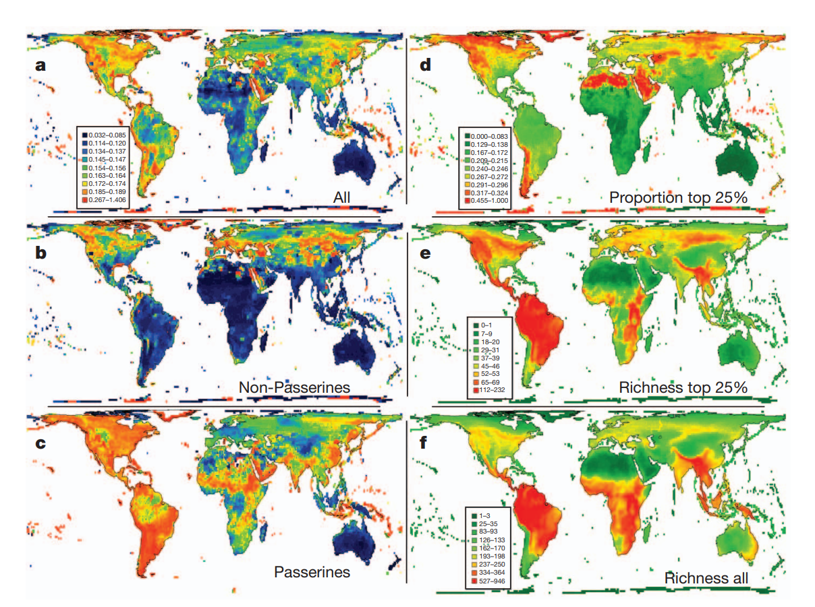
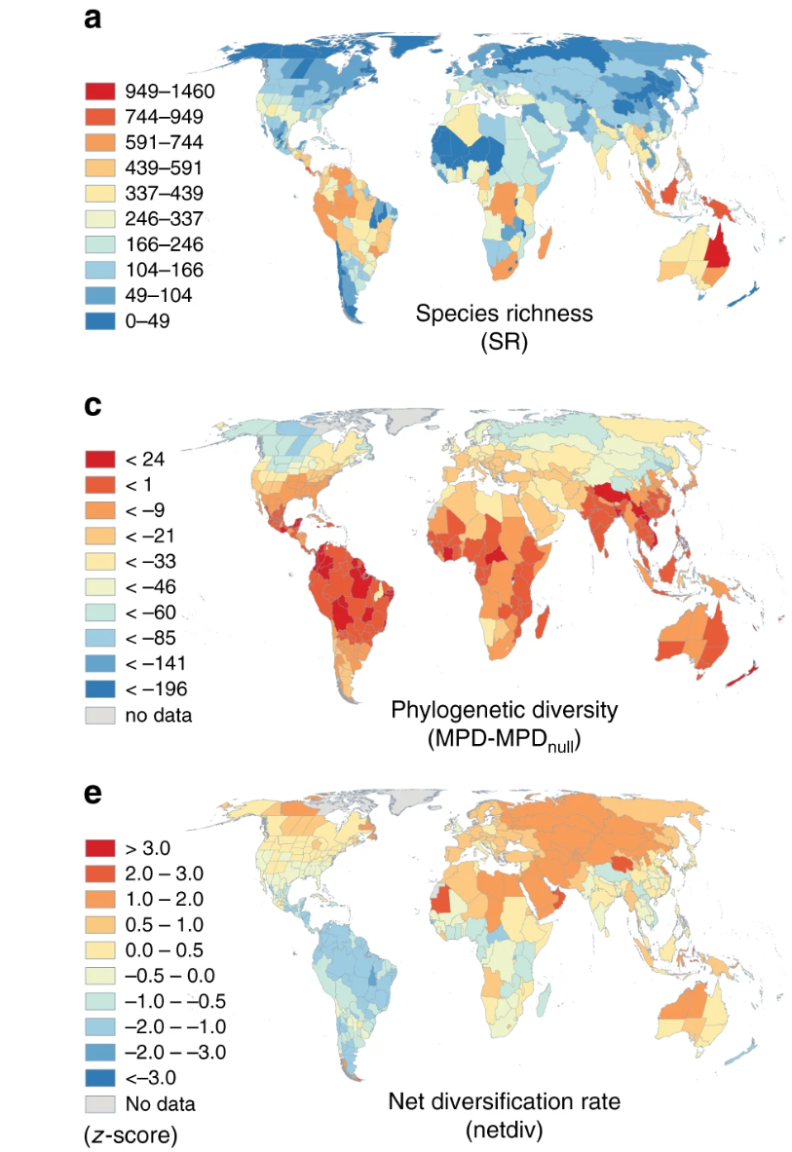
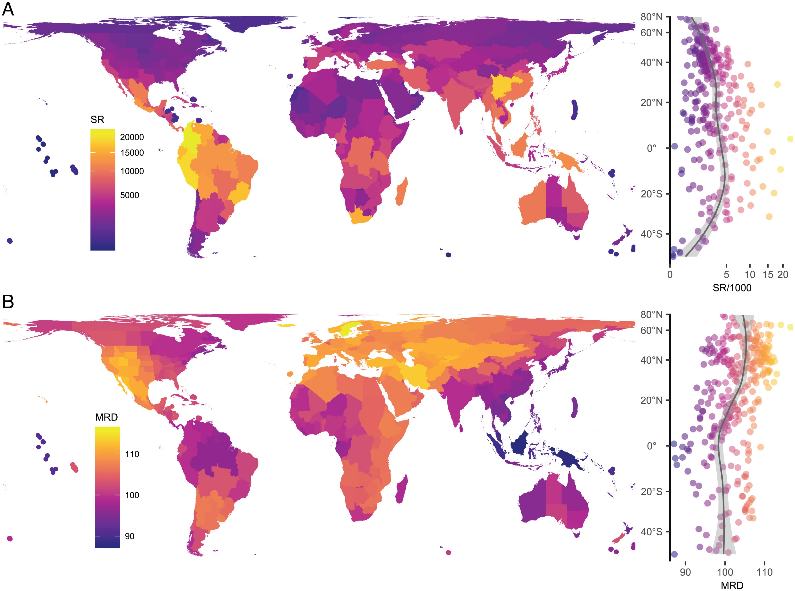
Zooming out: High species richness = high diversification?
Plants
Birds
Ants
Species
Richness
Diversification
rates
Tietje et al., 2022, PNAS: Global variation in diversification rate and species richness are unlinked in plants
Jetz et al., 2012, Nature: The global diversity of birds in space and time
Economo et al., 2018, Nature Comms: Macroecology and macroevolution of the latitudinal diversity gradient in ants

Slide 41
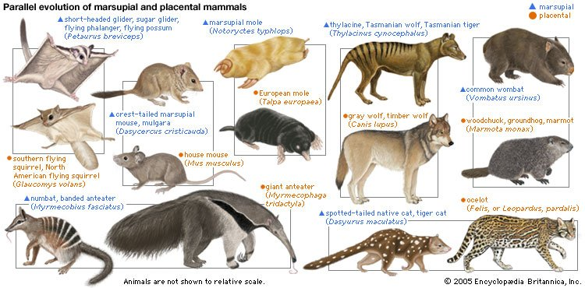
What supports the idea of evolution?
Hierarchical structure of similarity in nature.
The existence of homologies and parallel evolution.
Fossils.
Imprints in embryonal development.
Imperfect nature of some traits.
Non-random distribution of organisms and traits.
It can also be re-created by humans, either experimentally (on drosophila, bacteria, …), or by breeding

Slide 42
Phylogeny
Evolutionary trees and how to read them

Slide 43
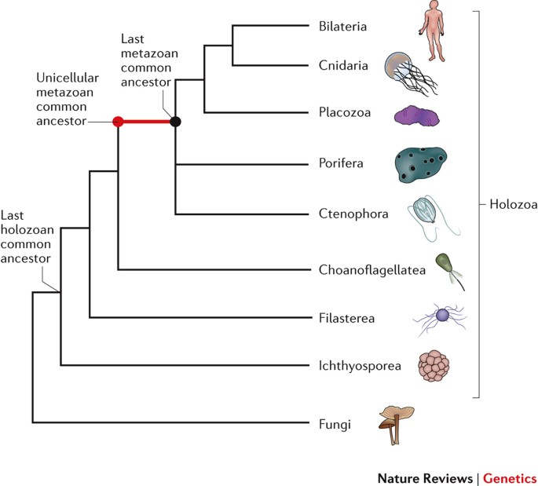
Phylogeny – the tree of life
Sebé-Pedrós et al., 2017, Nat. Rev. Genet.
Side note: Unrooted, partially unresolved cladogram showing the branching order and evolution of multicellular organisms

Slide 44
Phylogeny – the tree of life
Sebé-Pedrós et al., 2017, Nat. Rev. Genet.
Side note: Unrooted, partially unresolved cladogram showing the branching order and evolution of multicellular organisms

Slide 45
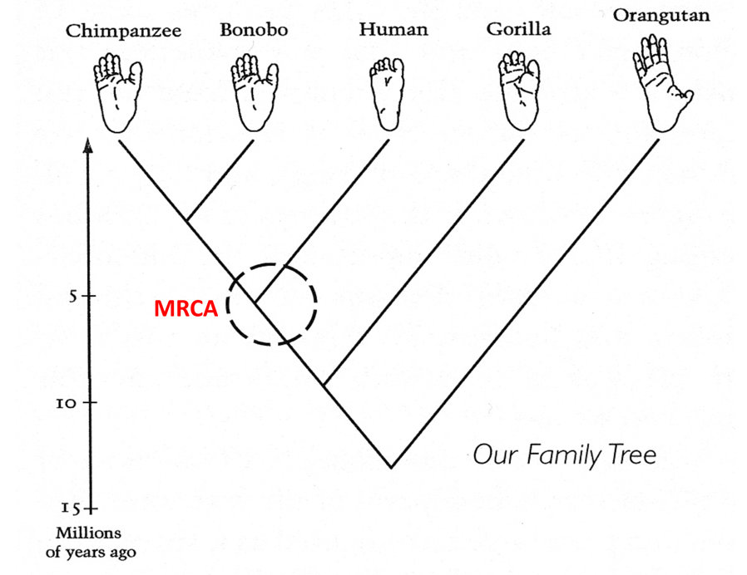
Phylogeny – the tree of life
Pan
Homo
MRCA = Most Recent Common Ancestor
Adapted from The Demonic Male (Mariner Books, 1997) by Richard Wrangham
Side note: This is a rooted, resolved chronogram

Slide 46
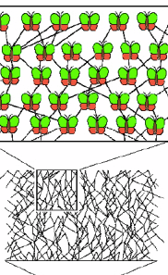

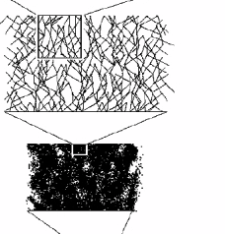
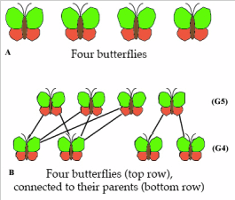
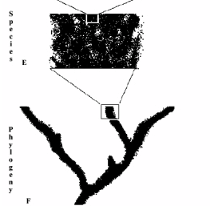
What is a phylogenetic tree?
Individual
Population
Species
Phylogeny
Darwin mentioned that a „coral of life“ may be a better metaphor than the tree

Slide 47
How to read a phylogeny
Terminal Nodes or present-day taxa
Branches or
Lineages
A
B
Represent the
taxa (genes,
populations,
species, etc.)
used to infer
the phylogeny
C
D
Ancestral Node
or root of
the tree
Internal Nodes or
Divergence Points (represent hypothetical ancestors of the taxa)
E

Slide 48
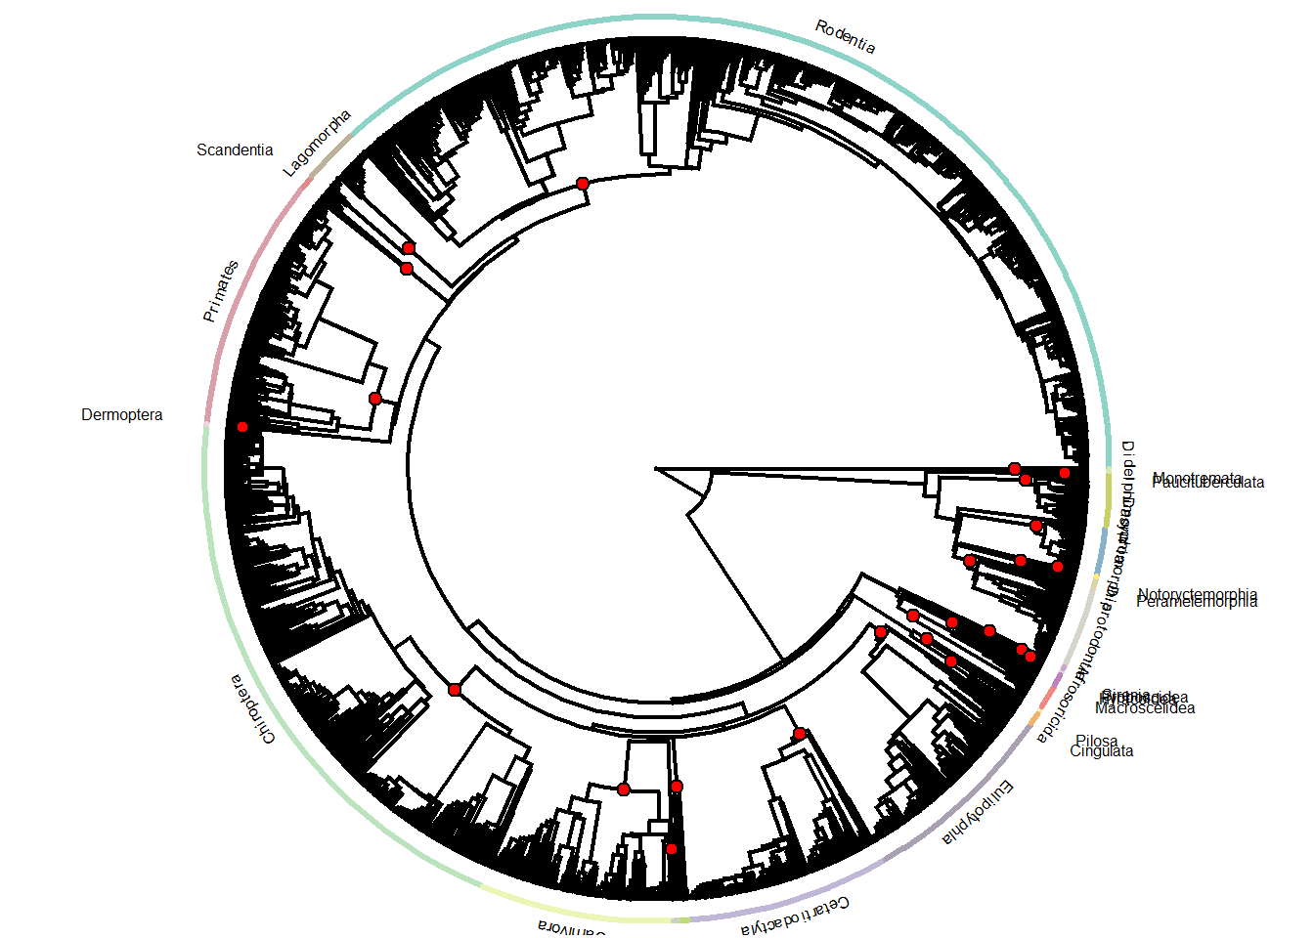
Types of phylogenetic trees
Cladogram
= only represents the branching-pattern, but is unscaled (branchlengths are not representative of anything, internal nodes MAY not represent ancestors)
Phylogram
= Branch lengths are proportional to te amount of character change (e.g., genetic distance)
Chronogram
= Branch lengths represent time
B
genetic distance (d)
6
Taxon B
A
1
1
Taxon C
3
C
1
Taxon A
5
Taxon D
D

Slide 49
Similarity vs. evolutionary relationship
Similarity and Evolutionary relationship are not the same thing, even though evolutionary relationship is inferred from certain types of similarity:
Similar: having likeness or resemblance (observation)
Related: genetically connected (historical fact)
Two taxa can be very similar without being most closely-related:
genetic distance (d)
6
Taxon B
1
1
Taxon C
3
C is more similar in sequence to A (d = 3) than to B (d = 7), but C and B are most closely related:
C and B shared a common ancestor more recently than either did with A).
1
Taxon A
5
Taxon D
Side note: This is a phylogram

Slide 50
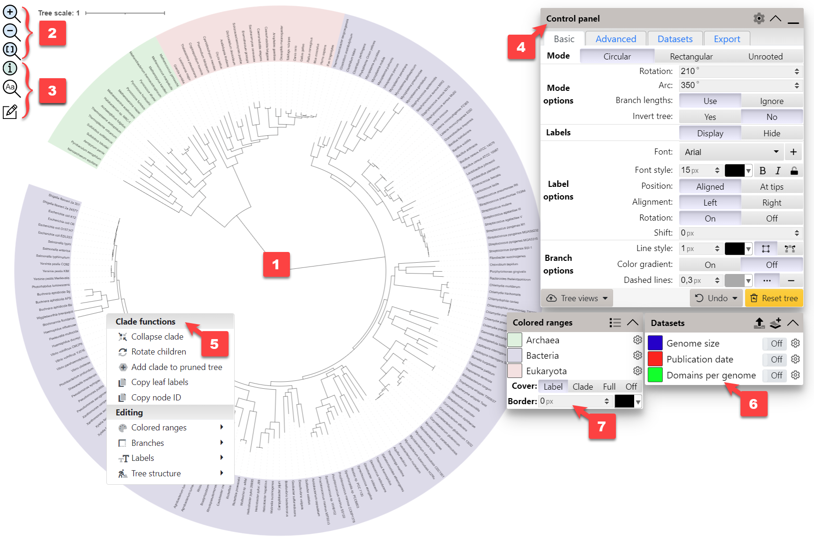
iTOL (interactive tree of life)
Collection of phylograms, tool to create, annotate, export your own tree (note: these are not time-dated)
https://itol.embl.de/itol.cgi

Slide 51
The magic of phylogenies
Example questions:
Where did taxon X originate?
Are species distributions reflecting dispersal distances or environment?
Did taxon X evolve gradually or was there a diversification burst? Adaptive radiations?
Are communities shaped by competition or filtering?
Did species evolve here, or did they disperse here from somewhere else?
Which mode of speciation (allopatric, sympatric) and why?
Why is species diversity distributed so non-randomly on the surface of the Earth?
What are the processes generating the non-randomness (time, diversification, environment)?
What are the key factors constraining the geographic distributions of species? How do they translate into the evolutionary process?
What is the history of colonization, speciation, and extinction across taxa and regions?

Slide 52
The end

Slide 53
What you should remember
The number of taxa steadily increased through geological time
There have been 5 major extinction events (the “big five”) and we are likely approaching another one
Apart from extinction, the other process that generates biodiversity is speciation
The principle of Darwinian natural selection, and how it’s connected to speciation
Evolutionary relationships among organisms are represented by a phylogeny a.k.a. phylogenetic tree
Besides biological processes, biodiversity patterns globally are determined by extinctions and plate tectonics
Resource: Origins of Biodiversity, Bromham & Cardillo, 2019 (Book) *click for pdf*

Slide 54
Lecture Part 2: Practical Introduction to eco-evolutionary simulation models
Biological Background

Slide 55

Who are you?
https://forms.office.com/e/4Rr4zzeTzi

Slide 56
Intro to eco-evo simulation models: Fundamental processes
Fundamental processes that determine how many species there are in a given area:
Speciation = production of new species
Extinction = loss of species
Dispersal = immigration/emigration of species
… but also:
The landscape (the ‘arena’ where species live and evolution works)
Evolution and adaptation (traits change naturally due to stochastic processes)
The ecological niche of the species (determines the abundance of individuals)

Slide 57
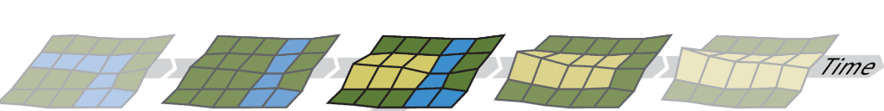
Processes shaping biodiversity (according to gen3sis)
Time
Landscape
Ecology
ecological niche ~ abundance
Dispersal
Effect of barriers ~ Population connectivity
Mutation
Trait change
Speciation
Geographic isolation and connectivity

Slide 58
Thanks!
I‘ll see you in the practical ☺

